Slide 1

AirBnb Price Prediction in NY Area
Vera Guzelsoy

Slide 2
Why? – For Whom?
PURPOSE
To create a model that explores pricing metrics in NYC and
To predicts rental prices for the upcoming period.
STAKEHOLDERS
NYC Housing Authority
Tourism Tour Organizations while accounting their tour costs
Tourists planning to visit NYC
-Airbnb App users
-Airbnb Hosts And Potential Hosts while balancing their rent prices
-Airbnb Application Improvers
-Other Hosting Application Member Users(such as Booking.com)
-NewBie Hosting Application Startup Investors.

Slide 3
Business Outcome:
-Airbnb users as bookers can see the forecast price in terms of location and seasons over the
year before reserving their rental place.
-Airbnb users as hosts are able to see appropriate listing prices by checking this model, so
they will not list the place for under or over price.
-Airbnb application creators can check this model to improve their recommendation system
for bookers.
-Airbnb investors will also have the advance derived from mutualist benefits between hosts
and bookers.
-Other hosting app users can check this model for balancing their rental prices.

Slide 4
Dataset:
This open-source data set includes 16 columns and 48895 rows providing Airbnb listing information and metrics for hosts, places and geographical features in NYC, NY area between the years 2008 and 2019.
The data is sourced from the Inside Airbnb website http://insideairbnb.com/get-the-data.html
which hosts publicly available data from the Airbnb website.

Slide 5
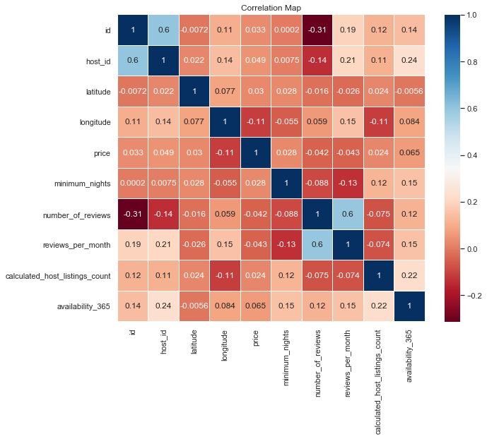
Overall, all correlation between column categories are weak

Slide 6
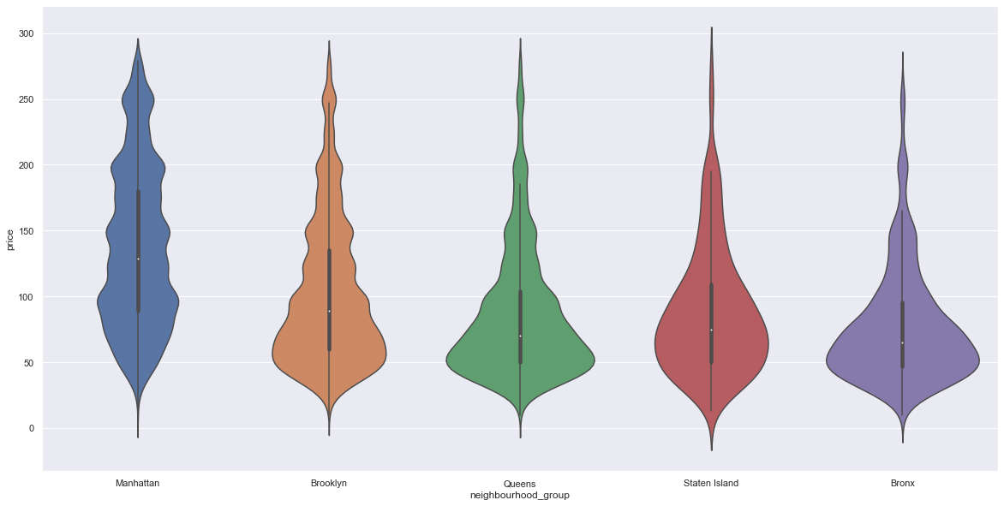
Price disperse related to boroughs:

Slide 7
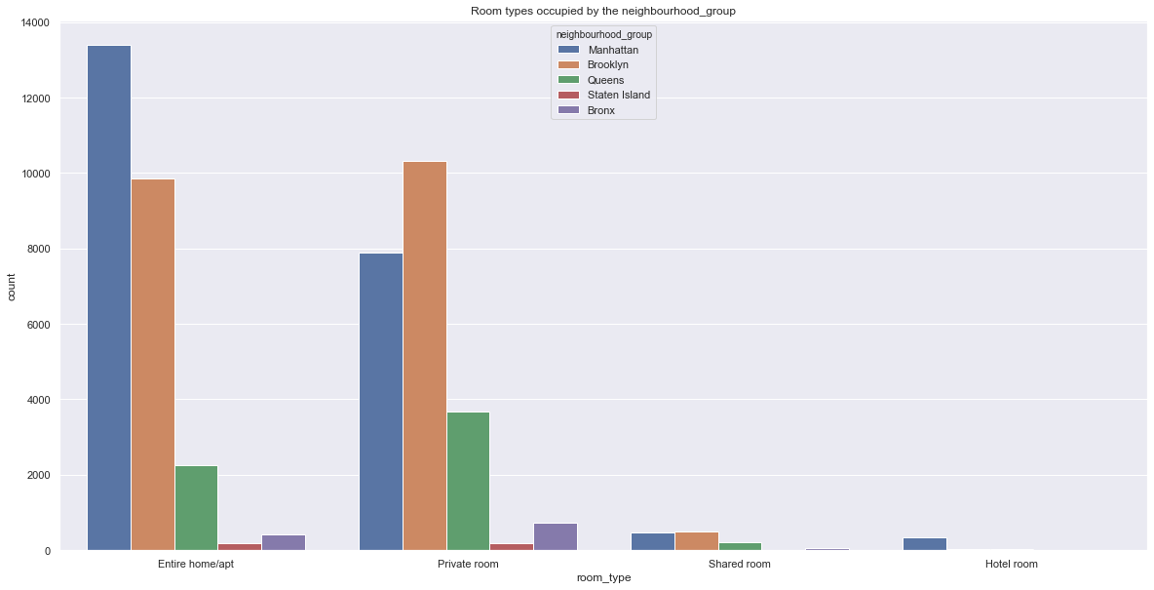
Hotels are listed on Airbnb mostly for Manhattan which has also the most amount of Entire home-Apt listings. Brooklyn's listings are generally based on Private Room. While shared rooms and hotel rooms are the least popular listings, the entire room and private rooms listings significantly have higher demand.

Slide 8
Statistics
To do an analysis of variance, I am going to use ANOVA instead of t-test because there are more than
2( 5 ) boroughs to compare their means of prices
1) Bronx-Queens
2) Bronx-StatenIslands
3) Queens-StatenIslands
all other pairwise comparisons for treatments rejects the null hypothesis and indicates statistically significant differences.

Slide 9
Machine Learning
Ridge Regression (L2) Ridge MSE: 112016.44348145518
Lasso (L1) Lasso MSE: 112015.2263969845
Elastic Net ElasticNet MSE: 112019.65551282265
XGBoost
XGBRegressor MSE: 84716.541772843

